Slide 1
GIS Specialty Group Friday Activities
The Waldo Tobler Distinguished Lecture in GIScience
Friday, 4/11/2014, from 2:40 PM - 4:20 PM in Ballroom A, TCC, First Floor
Dr. Matt Duckham, Associate Professor in Geographic Information Science at the University of Melbourne, Australia.
Title: Geographic Information Expertise
----

Slide 2
GIS Specialty Group Friday Activities
The Tobler Distinguished Lecture will be followed by the presentation of the Robert T. Aangeenbrug Distinguished Career Award to Dr. Gerard Rushton, Professor Emeritus, and Department of Geography at the University of Iowa
---------------------------------------------------------
GIScience Specialty Group and Transactions in GIS Reception
The Reception will be held at The Landing in the TCC from 6:20 to 8:20 pm.
The reception immediately follows the Transactions in GIS Plenary (4:40 PM - 6:20 PM in Ballroom A, TCC, First Floor)

Slide 3
Somayeh Dodge
Assistant Professor of GIScience
Department of Geography & Environmental Studies, University of Colorado
Incoming Chair
Daniel Goldberg
Assistant Professor of Geography,
Incoming Academic Councilor
Texas A&M University
Outgoing Chair
John Rogan
Associate Professor of Geography
Clark Graduate School of Geography
Clark University, Worcester MA
Outgoing Treasurer/Secretary
Ryan Burns
PhD Candidate, Geography
University of Washington

Slide 4

Incoming Vice Chair
Dr. Diansheng Guo is an Associate Professor of Geography at the University of South Carolina
His research interests include GIScience, information visualization, spatial data mining and knowledge discovery, spatial optimization, and their applications in various geographic domains.
He is currently on the editorial board for Transactions in GIS, Professional Geographer, and Cartography and Geographical Information Science.

Slide 5
Incoming Treasurer/Secretary
Xinyue Ye is an Assistant Professor of Geography at Bowling Green State University
He is a geographic information scientist and human geographer, with expertise in space-time data mining, spatia econometric and spatial analysis toolbox development.
In his research, he integrates quantitative and qualitative methods in interdisciplinary setting, exploring inequality issues across scales and in various geographical settings.

Slide 6
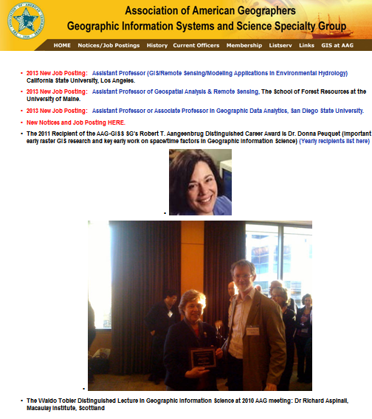
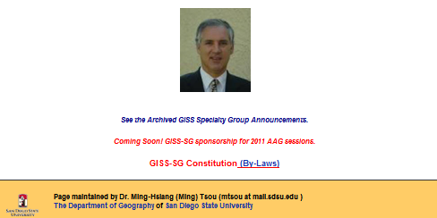
Current Website
http://geography.sdsu.edu/aaggis/

